Slide 1
Pointers in C programming
Md. Alamgir Hossain
Senior Lecturer,
Dept. of CSE, Prime University, Dhaka
Mail: alamgir.cse14.just@gmail.com

Slide 2

Pointers
The pointer in C language is a variable which stores the address of another variable.
This variable can be of type int, char, array, function, or any other pointer.
The size of the pointer depends on the architecture. However, in 32-bit architecture the size of a pointer is 2 byte.
Pointers (pointer variables) are special variables that are used to store addresses rather than values.

Slide 3
Address in C
If you have a variable var in your program, &var will give you its address in the memory.
We have used address numerous times while using the scanf() function. scanf(“%d”, &var);

Slide 4
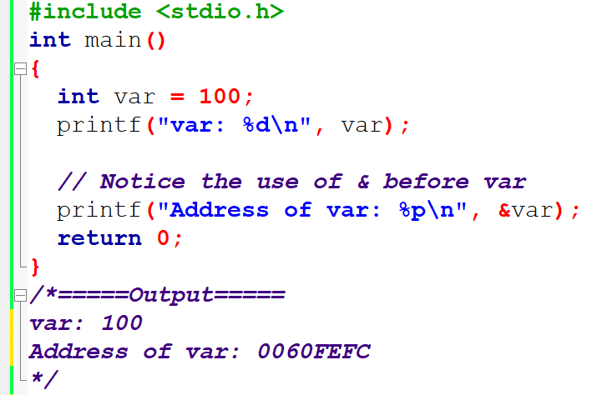
Pointers
Here, the value entered by the user is stored in the address of var variable.

Slide 5
Pointer Syntax
int* p; Here, we have declared a pointer p of int type.
int *p1; int * p2;
int* p1, p2; we have declared a pointer p1 and a normal variable p2.

Slide 6
Assigning addresses to Pointers
int* pc, c;
c = 5;
pc = &c;
Here, 5 is assigned to the c variable. And, the address of c is assigned to the pc pointer.

Slide 7
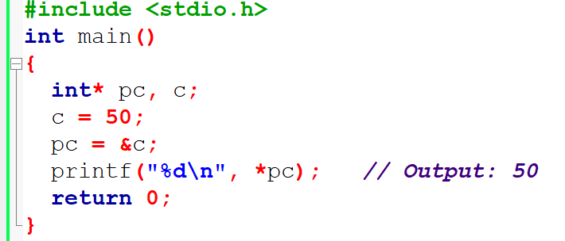
Get Value of Thing Pointed by Pointers

Slide 8
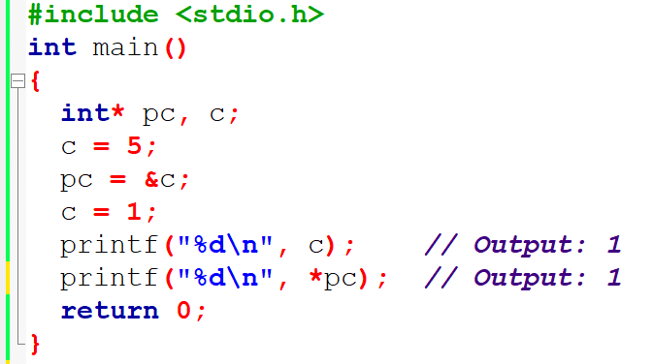
Changing Value Pointed by Pointers

Slide 9
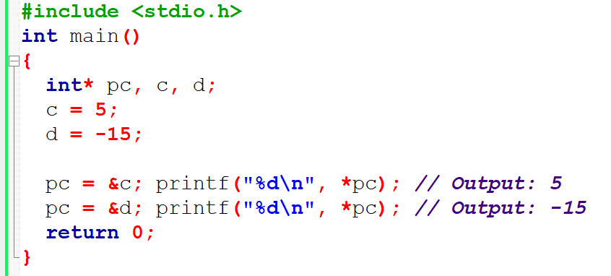
Changing Value Pointed by Pointers

Slide 10
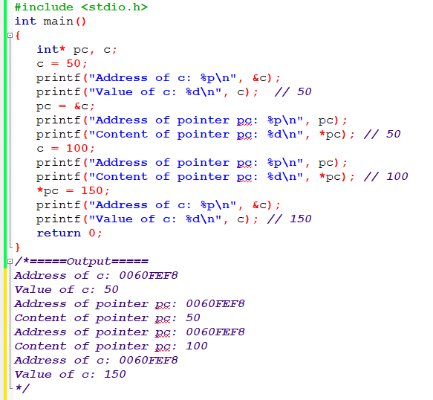
Example

Slide 11
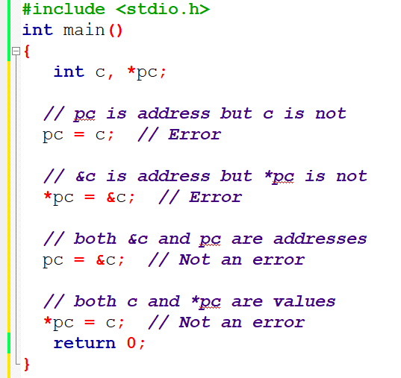
Common mistakes when working with pointers

Slide 12
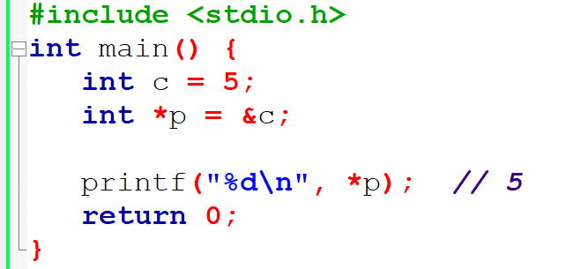
Confusing
Why didn’t we get an error when using int *p = &c;?
int *p = &c;
int *p; p = &c;

Slide 13
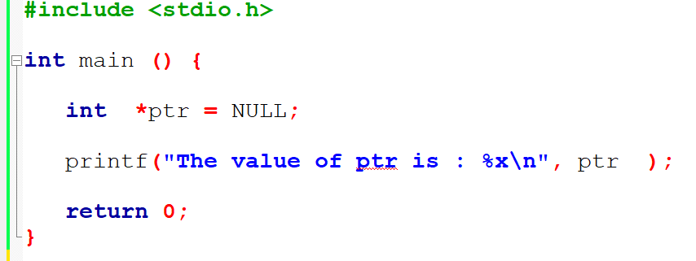
NULL Pointers
It is always a good practice to assign a NULL value to a pointer variable in case you do not have an exact address to be assigned. This is done at the time of variable declaration. A pointer that is assigned NULL is called a null pointer.

Slide 14
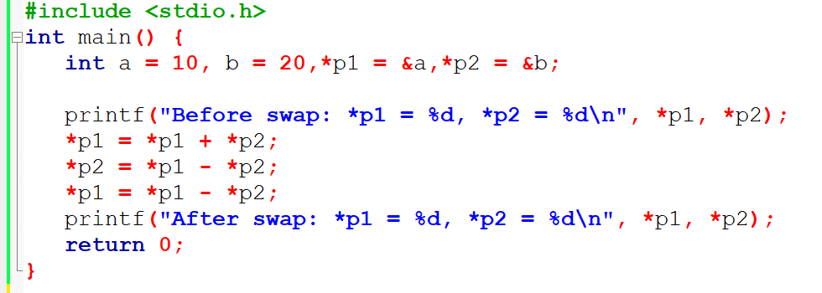
Swap two numbers without using the 3rd variable.

Slide 15
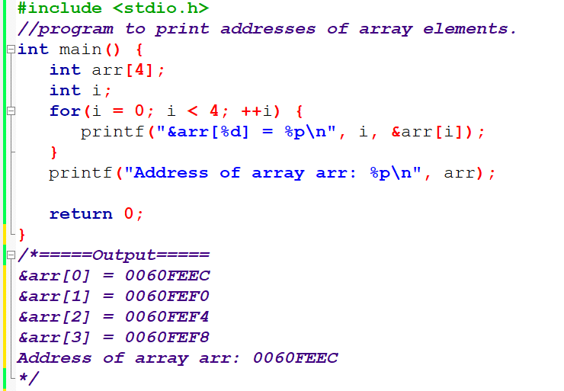
Relationship Between Arrays and Pointers

Slide 16
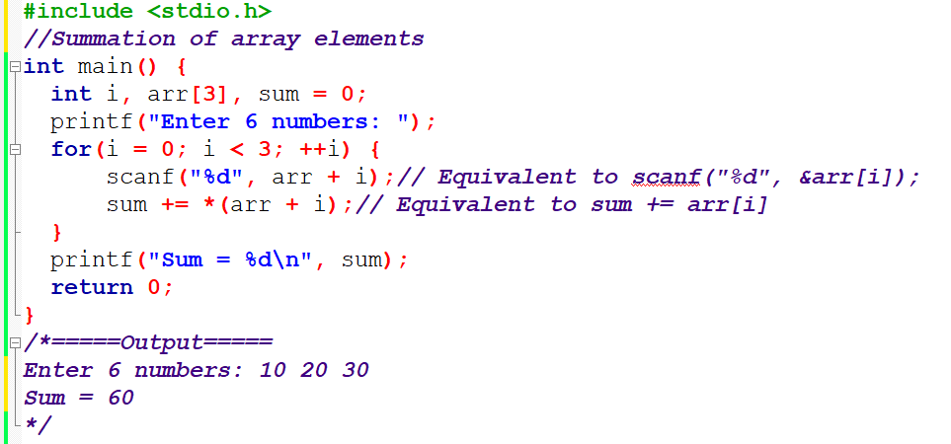
Example 1: Pointers and Arrays

Slide 17
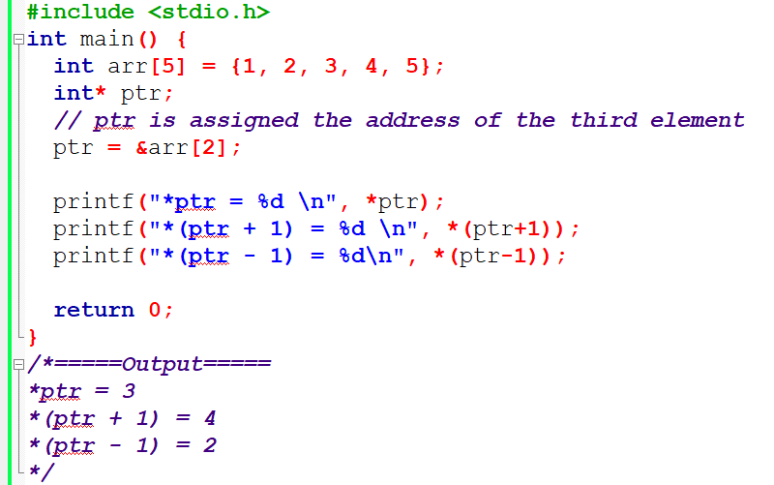
Example 2: Pointers and Arrays

Slide 18
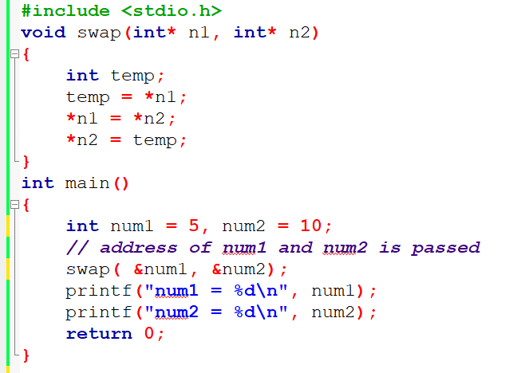
Pass Addresses to Functions

Slide 19
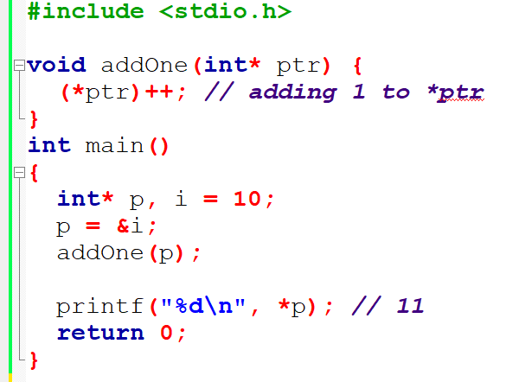
Passing Pointers to Functions

Slide 20
Passing Pointers to Functions

Slide 21
Copy One Array to Another using Pointers

Slide 22
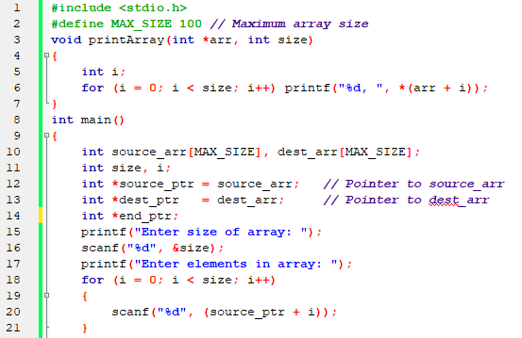
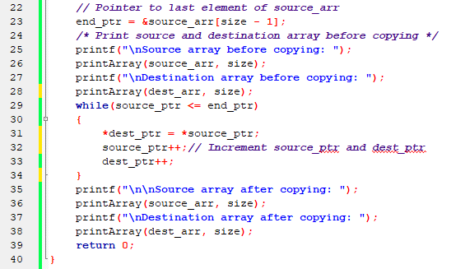

Slide 23
Why pointer is important?
Memory Access: Pointers provide a way to directly access and manipulate the memory that a program uses. This direct memory access is powerful and allows for efficient handling of data.
Dynamic Memory Allocation: Pointers are used with functions like malloc, calloc, realloc, and free to allocate memory dynamically at runtime, which is not possible with standard array types when their size needs to be variable.
Array Handling: In C, arrays are closely related to pointers. A pointer can iterate over an array’s elements by incrementing the pointer itself, often leading to faster array processing than with indexed access.
String Manipulation: Strings are managed with pointers in C. String variables are pointers to the first character of the string, making string manipulation in terms of pointers efficient and conventional in C libraries.
Efficient Function Parameters: By passing pointers to functions instead of actual data, you can pass large structures or arrays without copying the entire object, which saves stack space and can improve performance.

Slide 24
Why pointer is important?
Reference Passing: While C doesn’t support pass-by-reference directly, pointers allow you to emulate this behavior by passing the address of variables to functions, thereby allowing functions to modify the actual variables.
Complex Data Structures: Pointers are essential for the creation of complex data structures like linked lists, trees, graphs, and more. These structures involve nodes that use pointers to reference other nodes or elements.
I/O Buffers and Hardware Addressing: Pointers can be used to reference hardware addresses and manipulate I/O buffers, which is crucial for systems programming and interfacing with hardware.
Function Pointers: Pointers can be used to point to functions. This allows for dynamic dispatch of functions, callback functions, and implementation of finite state machines, among others.
Returning Multiple Values: Functions in C can use pointers to provide a way to return multiple values. By passing the addresses of several variables, a function can directly alter those variables, effectively "returning" more than one piece of data.

Slide 25
Homework
Write a C Program to reverse an array using pointers.

Slide 26
Thank You

